Slide 1
MIS 7720 #12 (Deep)NN for unsupervised learning Self-Organizing Maps, Auto Encoders

Slide 2
Self Organizing Maps (SOM)
Invented by Teuvo Kohonen in 1980s
Also called Kohonen maps
Use ANNs for dimensionality reduction
For example, convert multidimensional data to one or two dimensions
Unsupervised learning
SOMs learn to cluster data without supervision
Notes:
https://sci2s.ugr.es/keel/pdf/algorithm/articulo/1990-Kohonen-PIEEE.pdf

Slide 3
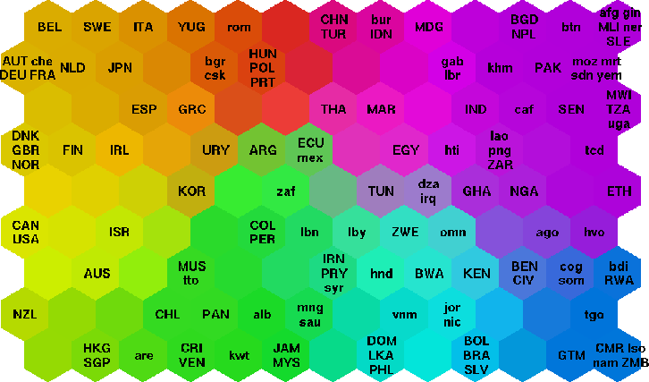
World poverty map example
Countries organized on a SOM based on 39 indicators describing various quality-of-life factors (e.g., state of health, educational services, …).
World Bank statistics 1992
Different/similar colors represent different/similar types of poverty.
Notes:
http://www.cis.hut.fi/research/som-research/worldmap.html

Slide 4
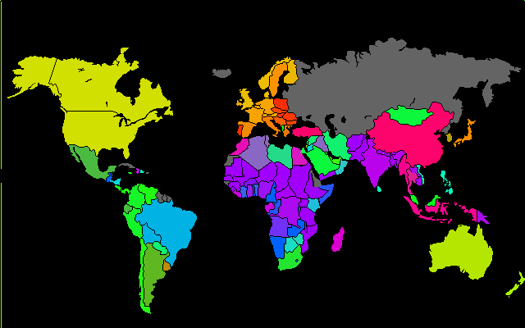
World poverty map example
We can then use the SOM to color each country on the geographic map in a straightforward manner.

Slide 5
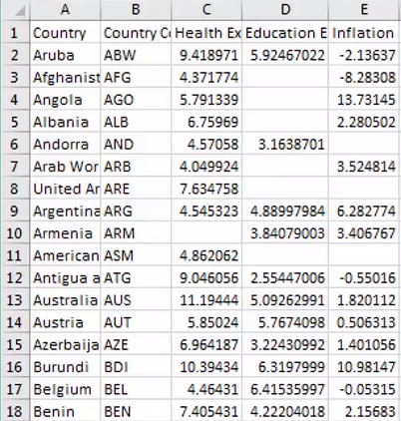
World poverty map example

Slide 6
Clustering refresher
Presentation #7 Unsupervised learning

Slide 7
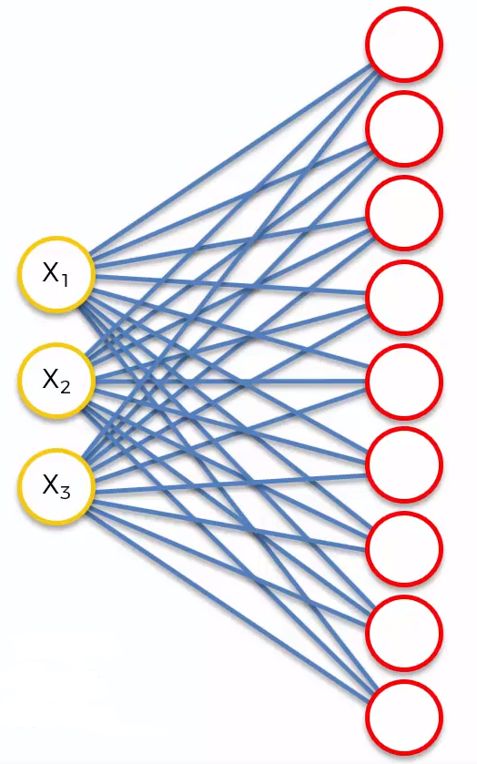
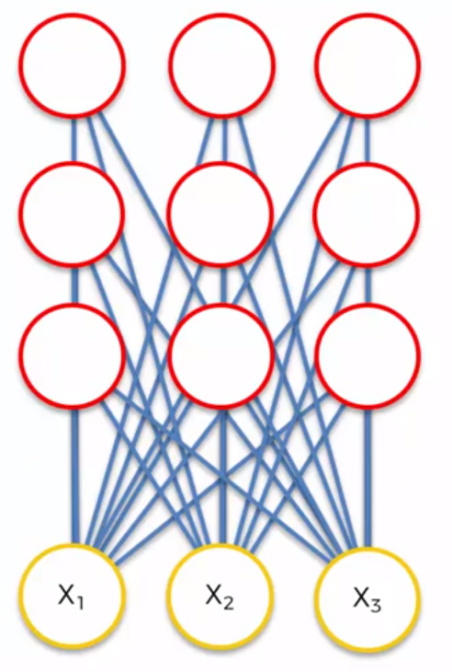
SOM training
Number of Input Nodes = number of features
Output nodes = 2D network of nodes
Reshape it

Slide 8
NOTE!
ANNs are used very differently in SOM compared to what we discussed before (e.g., CNN, RNN)
Weights are different
There is no activation function
No hidden layers

Slide 9
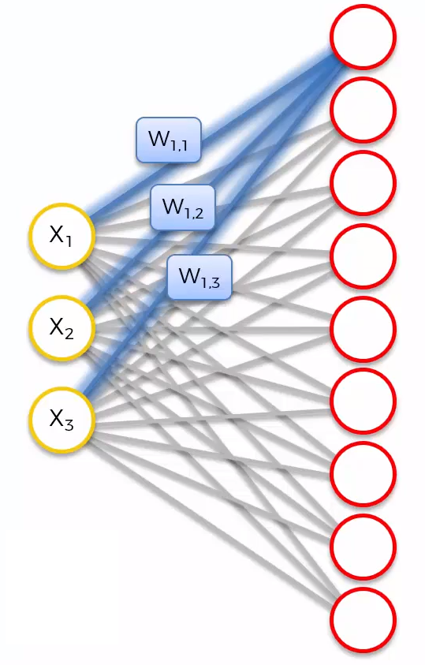
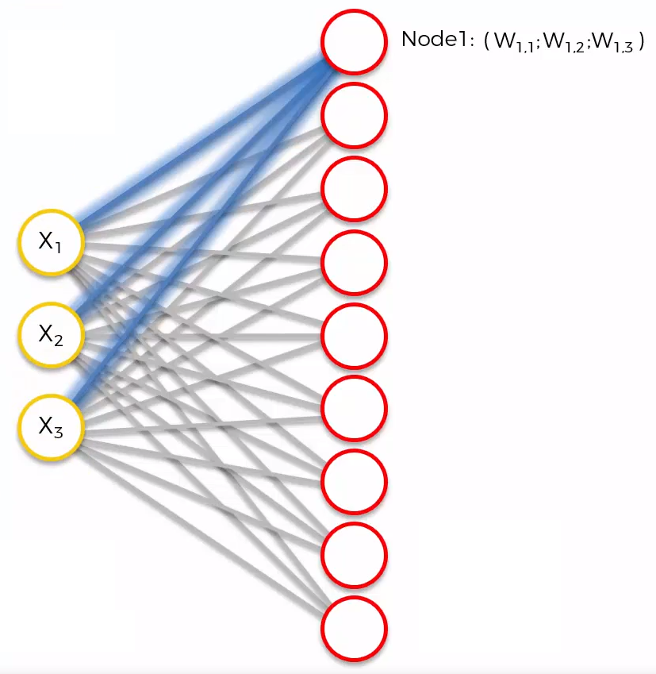
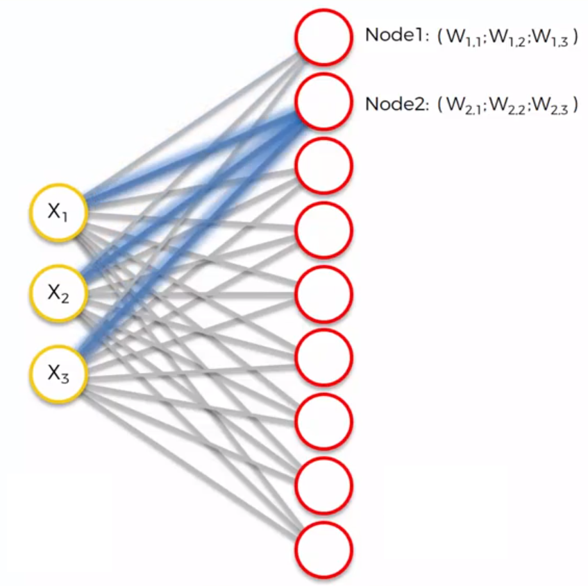
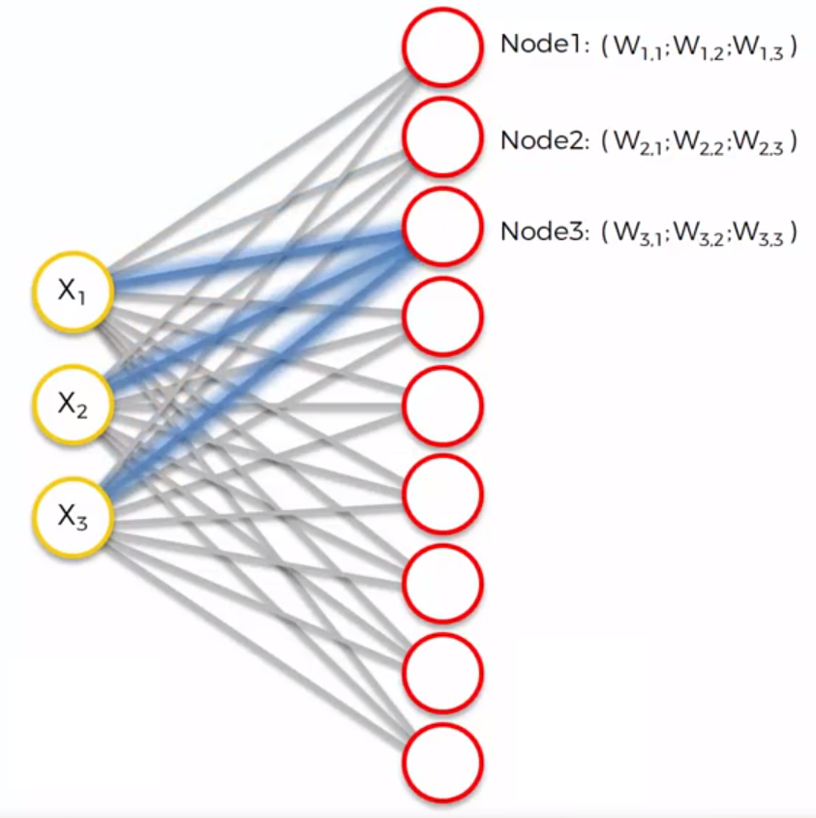
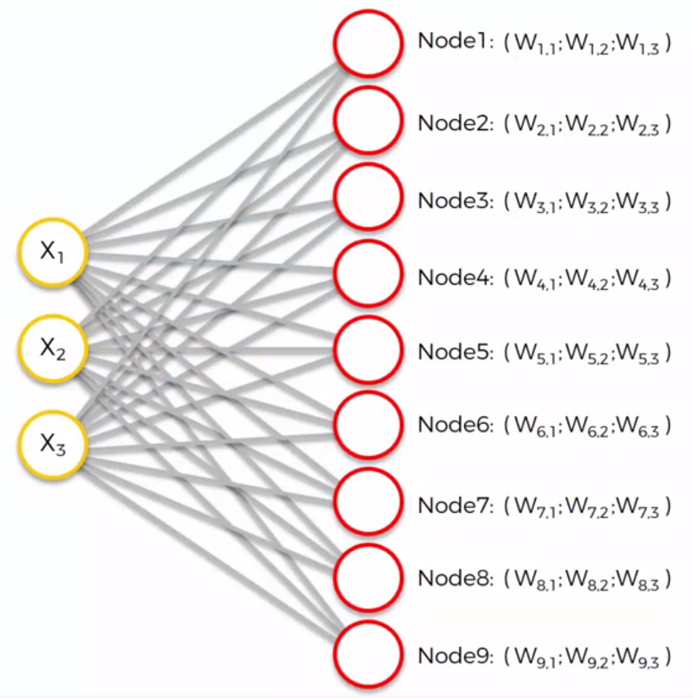
SOM training – ANN structure
Let’s focus on the 1st output node
Weights are characteristics of the output nodes
3D input space
The weights are the coordinates of the output node in the 3 dimensional input space
Each output node has its own weights

Slide 10
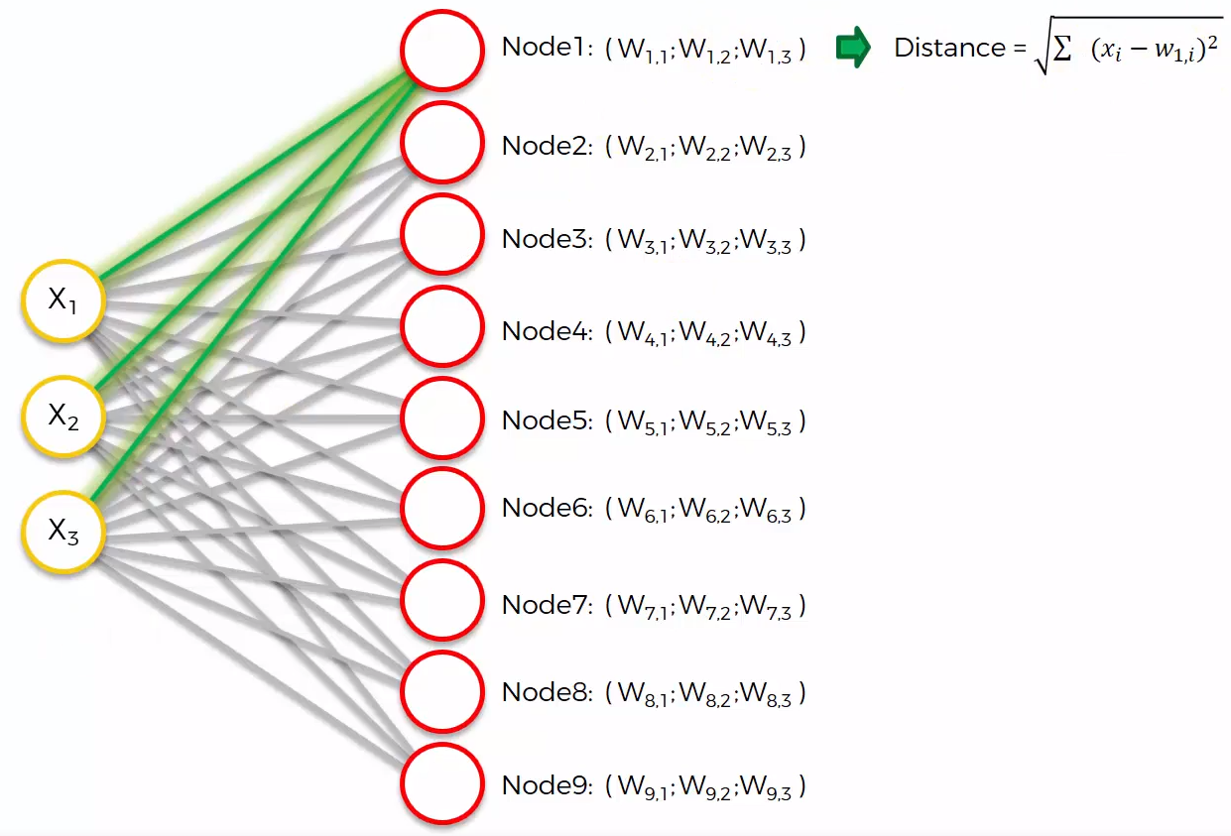
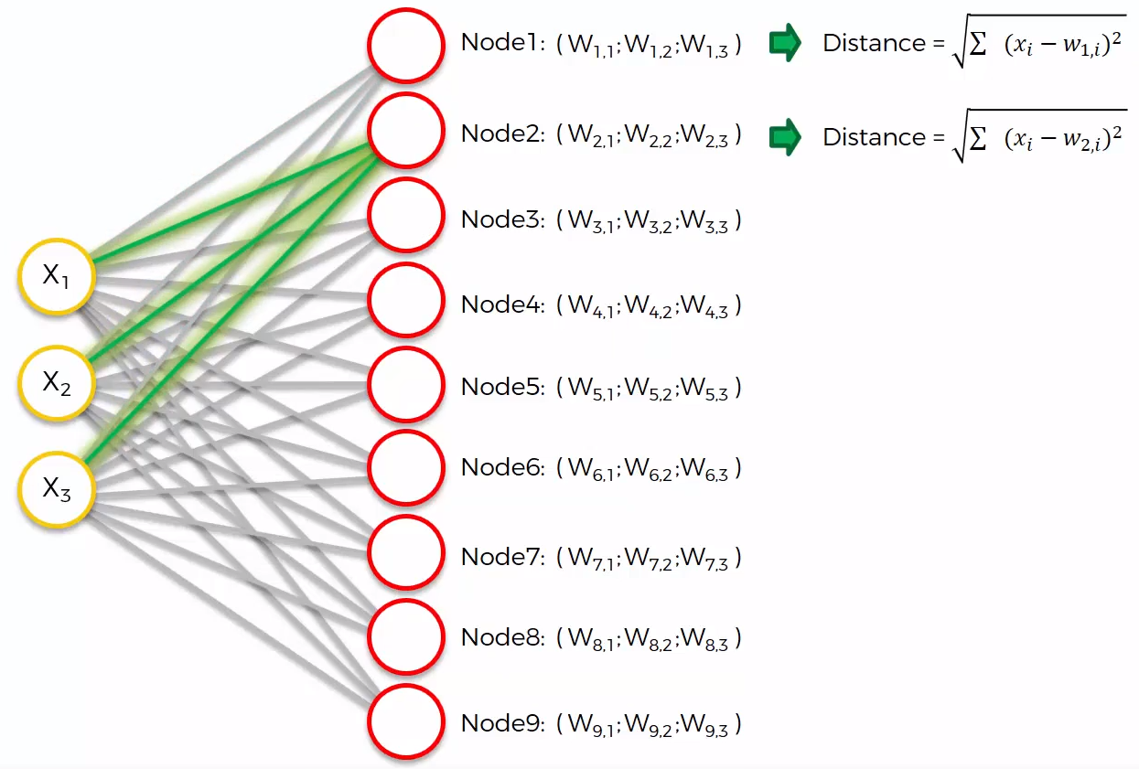
SOM training
We calculate the (Euclidean) distance of each output node to row 1 (distance to the original input space for row1).
Input data has to be normalized/standardized
Closest node is the Best Matching Unit (BMU)
1.2
0.8
Distance = 0.3
Distance = 1.2
Distance = 1.1
Distance = 0.9
Distance = 0.5
Distance = 1.3
Distance = 0.7

Slide 11
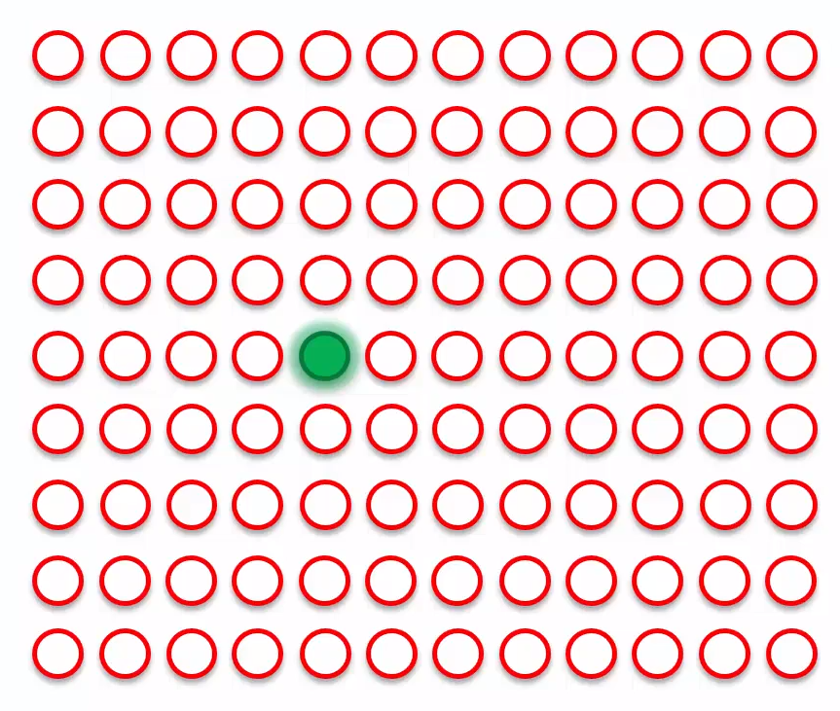
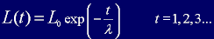
SOM training – BMU weight update
On a larger SOM…
The weights for the BMU node are updated to be closer to the original input
BMU for row 1
Notes:
http://www.ai-junkie.com/ann/som/som4.html

Slide 12
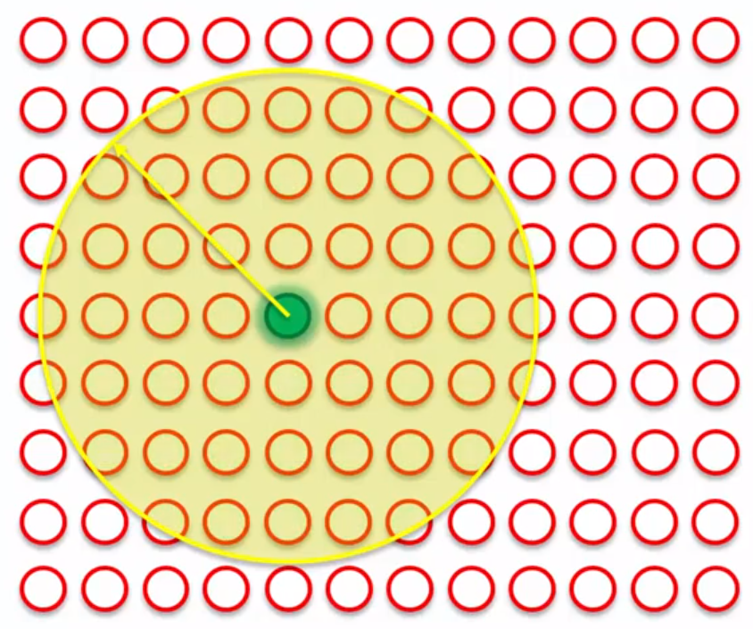
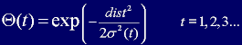
SOM training – nodes weight update
Weights of output nodes within a radius are updated as well
Closer nodes are updated more heavily
Farther nodes are updated less

Slide 13
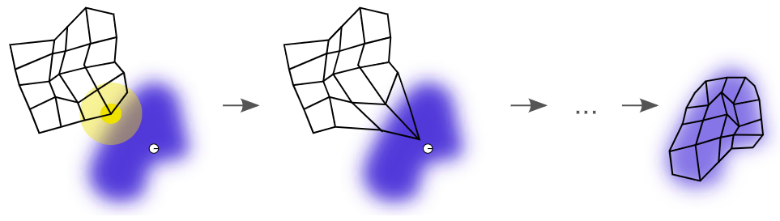
SOM training – BMU weight update

Slide 14
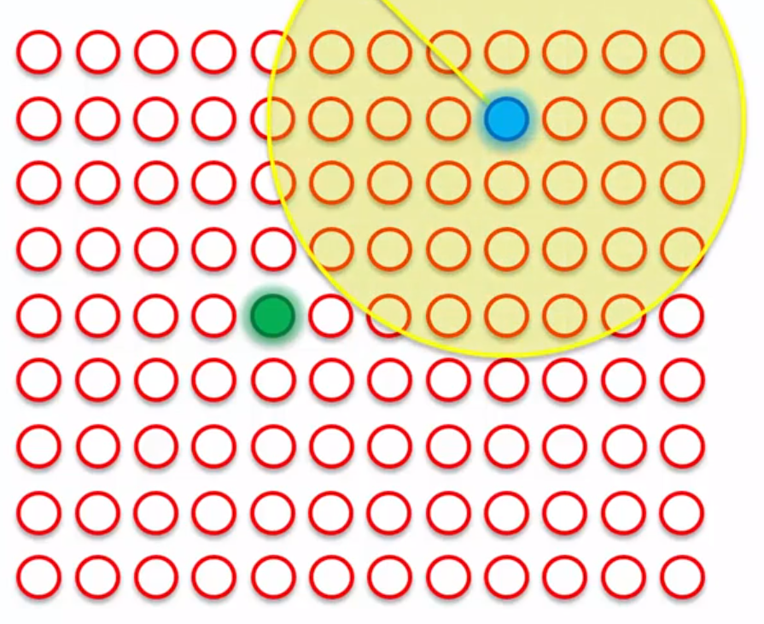
SOM training
Continue for other rows
Find BMU
Update weights
…
BMU for row 2

Slide 15
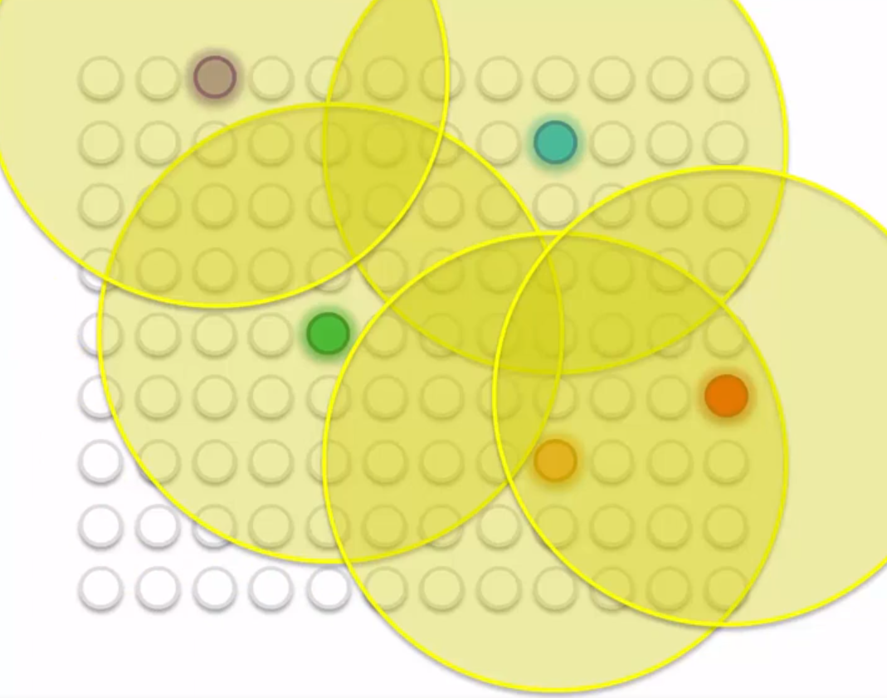
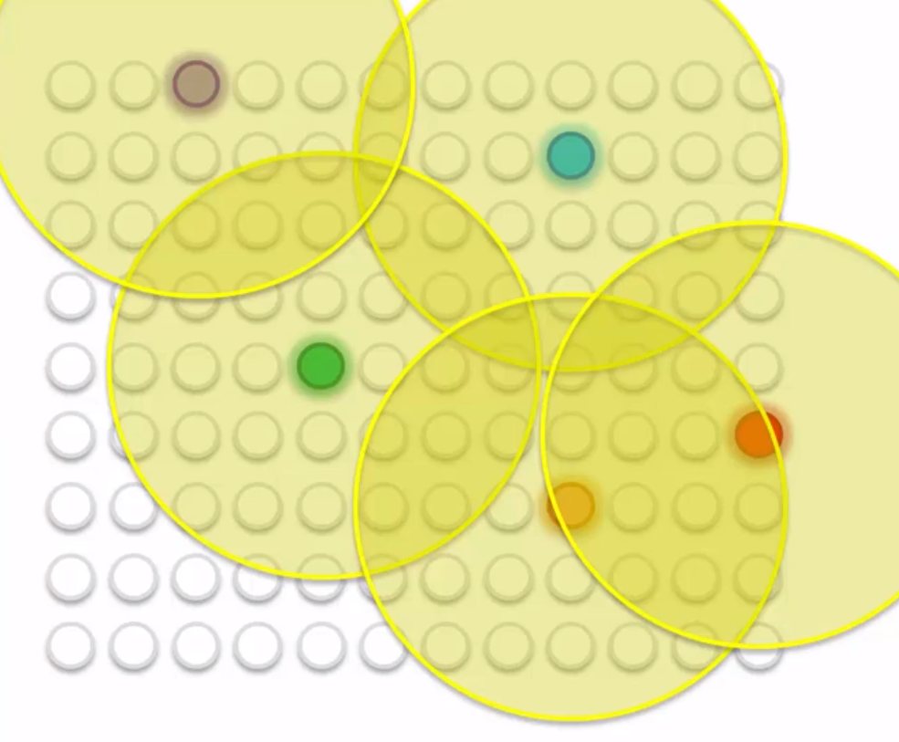
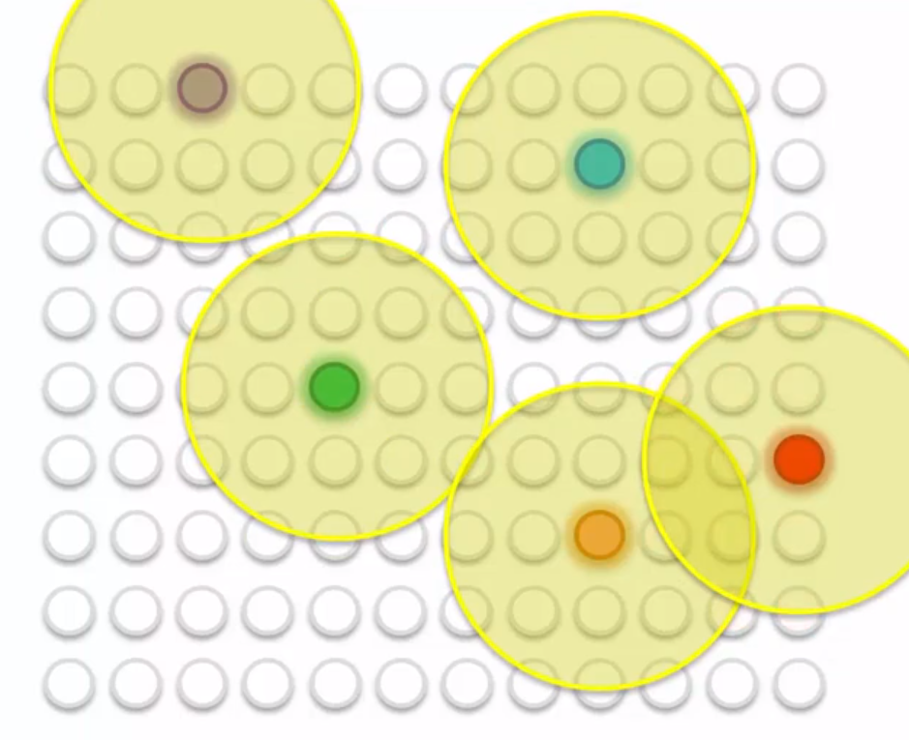
SOM training
After 5 rows (5 BMUs)
Once all rows are covered
Repeat iterations with smaller radius
Adjustments become more precise

Slide 16
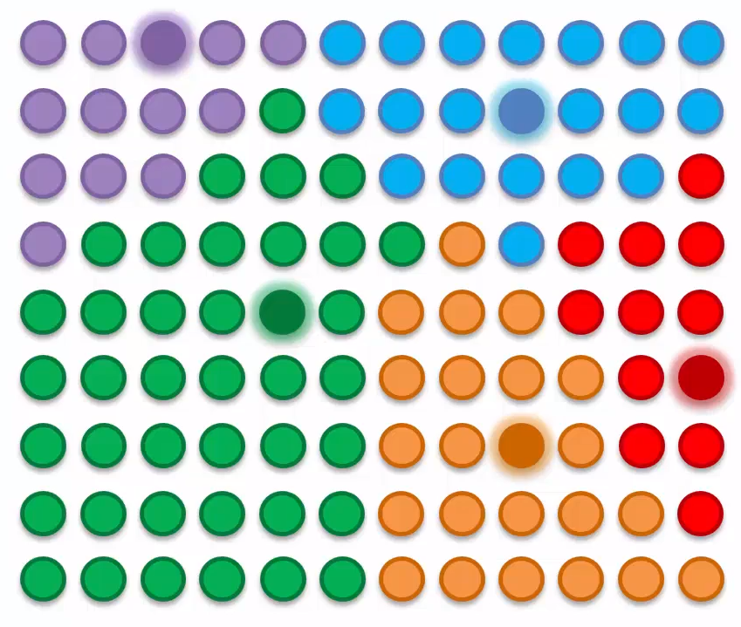
SOM training – Finally …

Slide 17
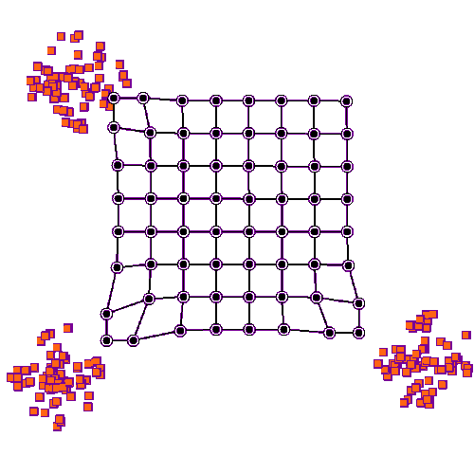
SOM training visualization on 2D data
Notes:
https://en.wikipedia.org/wiki/Self-organizing_map

Slide 18
SOM algorithm
Each node’s weights are initialized to small numbers (close to 0).
A row is chosen at random and fed to the input nodes (input vector).
Every output node is examined to calculate which one’s weights are closest to the input vector (using Euclidean distance). The winning node is the Best Matching Unit (BMU).
The radius of the neighborhood of the BMU is now calculated. This is a value that starts large, typically set to the 'radius' of the lattice but diminishes at each time-step. Any nodes found within this radius are deemed to be inside the BMU's neighborhood.
Each neighboring node's (the nodes found in step 4) weights are adjusted to make them more like the input vector. The closer a node is to the BMU, the more its weights get altered.
Repeat step 2 for N iterations.

Slide 19
SOM takeaways
SOMs retain topology of the input data
SOMs reveal correlations that are not easily identified
SOMs label data without supervision (unsupervised learning)
No target vector = no backpropagation
No lateral connections between output nodes
Notes:
For more details see:
http://www.ai-junkie.com/ann/som/som1.html
https://sci2s.ugr.es/keel/pdf/algorithm/articulo/1990-Kohonen-PIEEE.pdf

Slide 20
Autoencoders
Autoencoder (AE) is a type of artificial neural network architecture used to learn efficient data encodings, it learns:
a representation (encoding) of the input data by training the network to ignore noise.
a representation (decoding) as close as possible to its original input from the reduced encoding.
AE are used to solve unsupervised learning problems
But are technically considered a self-supervised learning algorithm since they are trained using a supervised learning method; the decoding learns how to map the encoded representation to the (known) output
Do a similar job as Principal Component Analysis (PCA) when used for dimensionality reduction

Slide 21
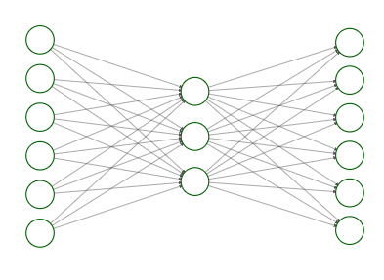
AE architecture
Encoding
Decoding
Input Nodes Hidden nodes Output Nodes

Slide 22
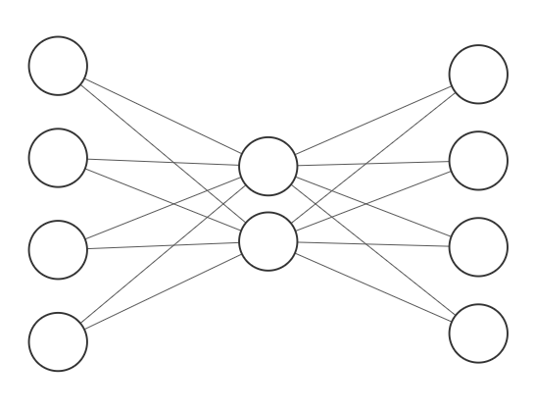
How does it work? simple example
1
0
0
0
Notes:
This simple example merely demonstrates how it is possible to encode 4 inputs using only 2 nodes. 1. Let say our input is 1-0-0-1
2. let’s say red edges have weight -1 , unmarked edges have weight +1

Slide 23
How does it work? simple example
1
0
0
0
1
1
Notes:
This simple example merely demonstrates how it is possible to encode 4 inputs using only 2 nodes. 1. Let say our input is 1-0-0-1
2. let’s say red edges have weight -1 , unmarked edges have weight +1
3. multiply/sum inputs by edge weights gives us values or hidden layer nodes [1,1]

Slide 24
How does it work? simple example
1
0
0
0
2
0
0
-2
1
1
Notes:
This simple example merely demonstrates how it is possible to encode 4 inputs using only 2 nodes. 1. Let say our input is 1-0-0-1
2. let’s say red edges have weight -1 , unmarked edges have weight +1
3. multiply/sum inputs by edge weights gives us values or hidden layer nodes [1,1]
4. Multiply/sum by node values by edge weights to get values for ouput nodes

Slide 25
How does it work? simple example
1
0
0
0
2
0
0
-2
Softmax
1
0
0
0
1
1
Notes:
This simple example merely demonstrates how it is possible to encode 4 inputs using only 2 nodes. 1. Let say our input is 1-0-0-1
2. let’s say red edges have weight -1 , unmarked edges have weight +1
3. multiply/sum inputs by edge weights gives us values or hidden layer nodes [1,1]
4. Multiply/sum by node values by edge weights to get values for ouput nodes
5. Apply softmax function on output values
More on Softmax:
https://deepai.org/machine-learning-glossary-and-terms/softmax-layer

Slide 26
Training Autoencoders
AEs use backpropagation to update weights so that we match outputs to inputs (similar to what we learned for ANNs).
Applications include
Dimensionality reduction
Information retrieval
Image processing
Anomaly detection
Machine translation
Collaborative filtering
recommender systems
Decoder
Encoder
Input layer Hidden layer Output layer

Slide 27
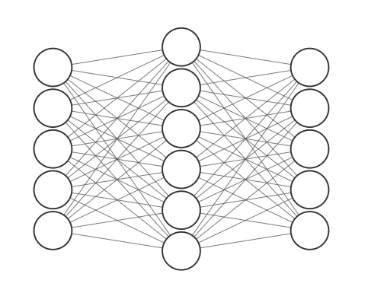
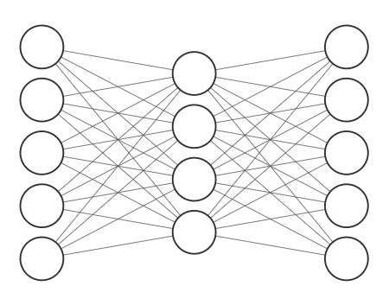
Autoencoder variations
Classic variations prevent autoencoders from learning the identity function and to improve their ability to capture important information and learn richer representations
Denoising AE
Sparse AE
…
1
2
3
4
5
X
1
2
3
4
5
1
2
3
4
?
1
2
3
4
5
1
2
3
4
5
1
2
3
4
Notes:
Figures show simple examples to illustrate the issue these AE variations correct:
The AE can just learn a direct mapping of the inputs in its hidden layer instead of feature representative, this is not what the AE is intended for.
https://en.wikipedia.org/wiki/Autoencoder#Variations

Slide 28
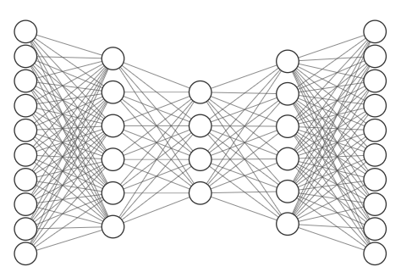
Autoencoder variations
Encoder
Decoder
Deep Autoencoders
Can reduce required training data
Can reduce computational cost of representing some functions
Code
Variational Autoencoders (VAE)
Learn a data generating distribution from the input data and can then (after training) generate output data (e.g., images, synthetic music) given some random sample as input
Convolutional VAE
VAE with convolution/deconvolution layers for encoding/decoding
Notes:
Intuition for variational Autoencoders:
https://towardsdatascience.com/intuitively-understanding-variational-autoencoders-1bfe67eb5daf
For details on variational autoencoders check out https://jaan.io/what-is-variational-autoencoder-vae-tutorial/
ConvVAE using tensorflow:
https://www.tensorflow.org/tutorials/generative/cvae

Slide 29
Questions?

